Slide 1
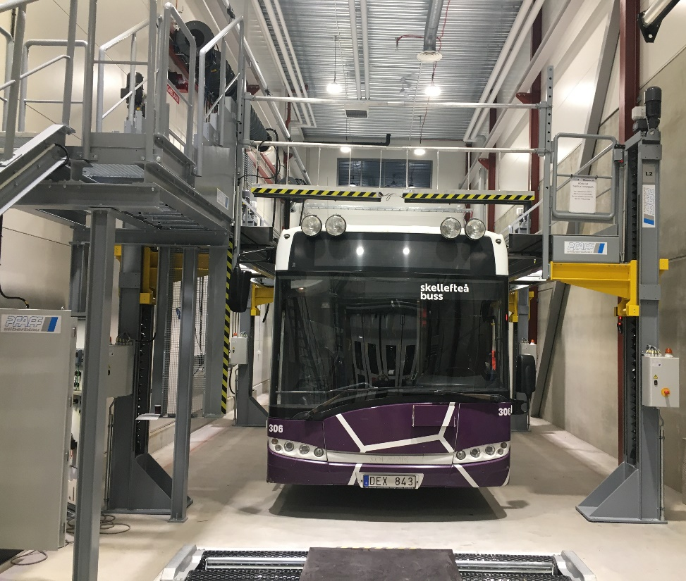
Extendible roof platforms for busses
Presentation of Pfaffs’ extendable roof platforms for buses

Slide 2
Dendro Lift AB
Swedish company with own development and manufacturing in Järvsö
Scandinavian agent for German Pfaff Silberblau for extendible roof platforms and train lifts
Focused on lifting heavy vehicles, industrial lifting solutions and safe working at heights
Nearly 50 years of heavy lifting experience
Customized solutions based on standard components
Works according to ISO 9001:2008 and ISO 14001:2004

Slide 3
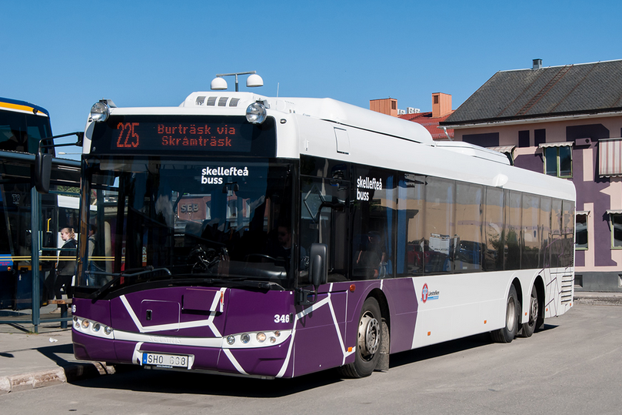
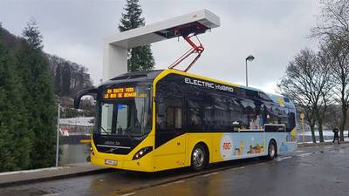
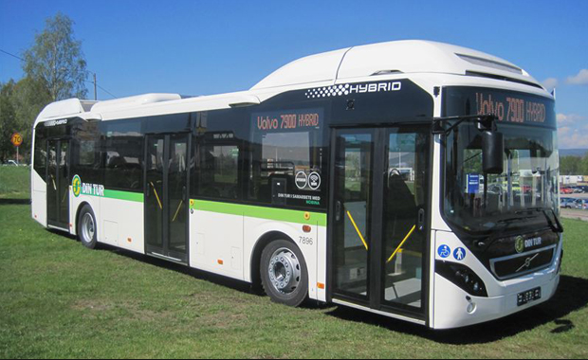
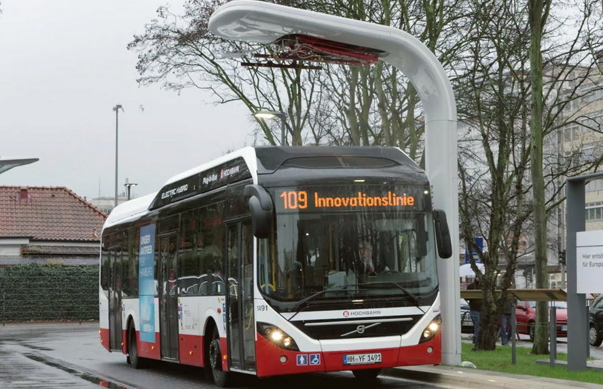
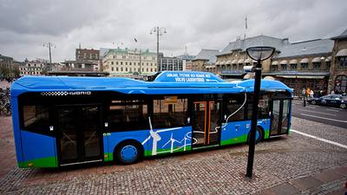
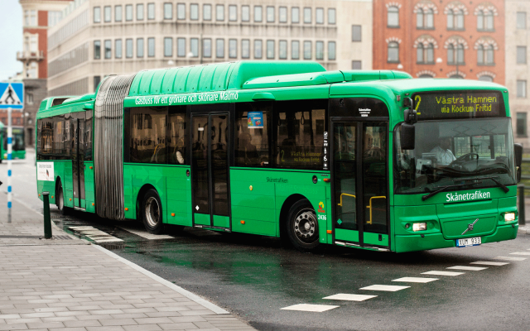
New buses with equipment on the roof

Slide 4
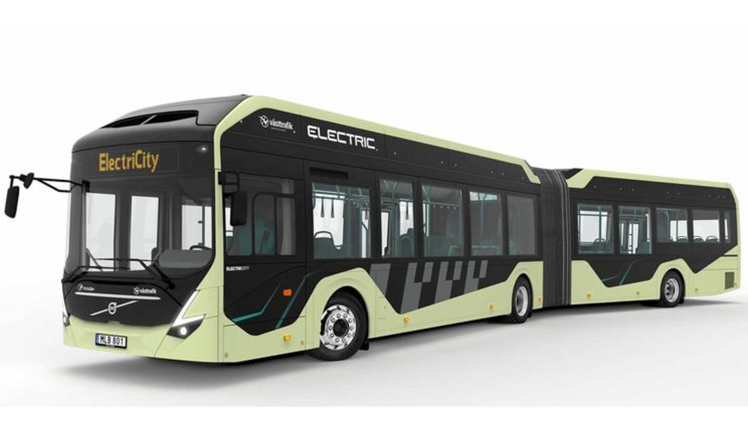
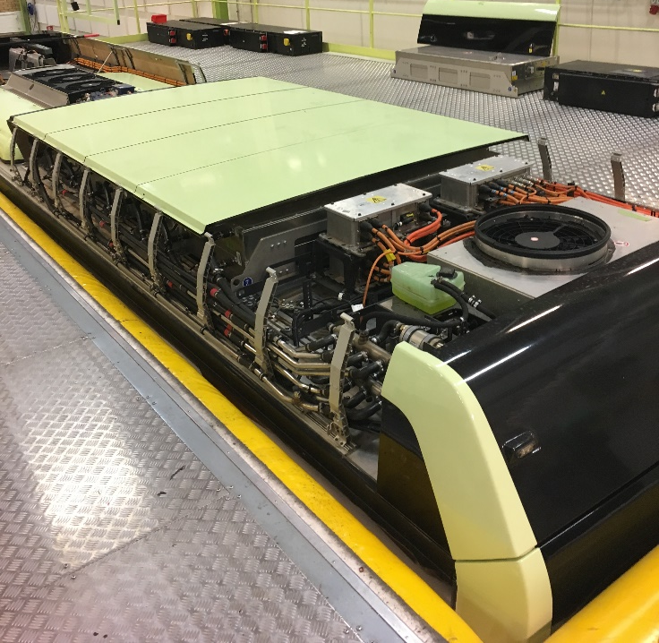
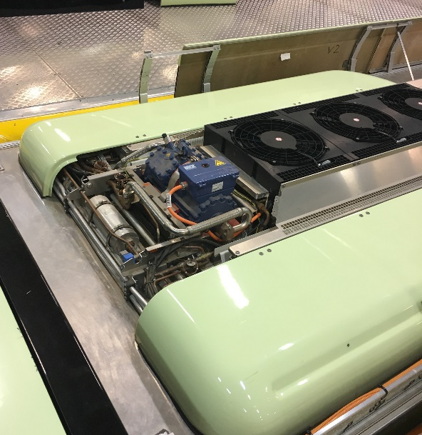
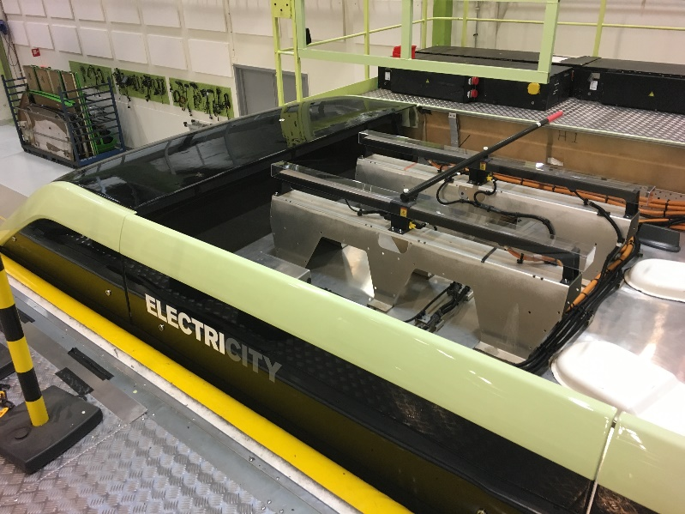
Example of roof equipment on an electric bus

Slide 5

Work at height
One of the most common and serious types of workplace accidents is work at height
Fixed fall protection better than personal
The Swedish Work Environment Authority (Arbetsmiljöverket) states:
“Personal protective equipment can only be used in exceptional cases where collective protection is not possible to use, or where the time to get these devices in place takes significantly longer than it takes to carry out the work task in question.”

Slide 6
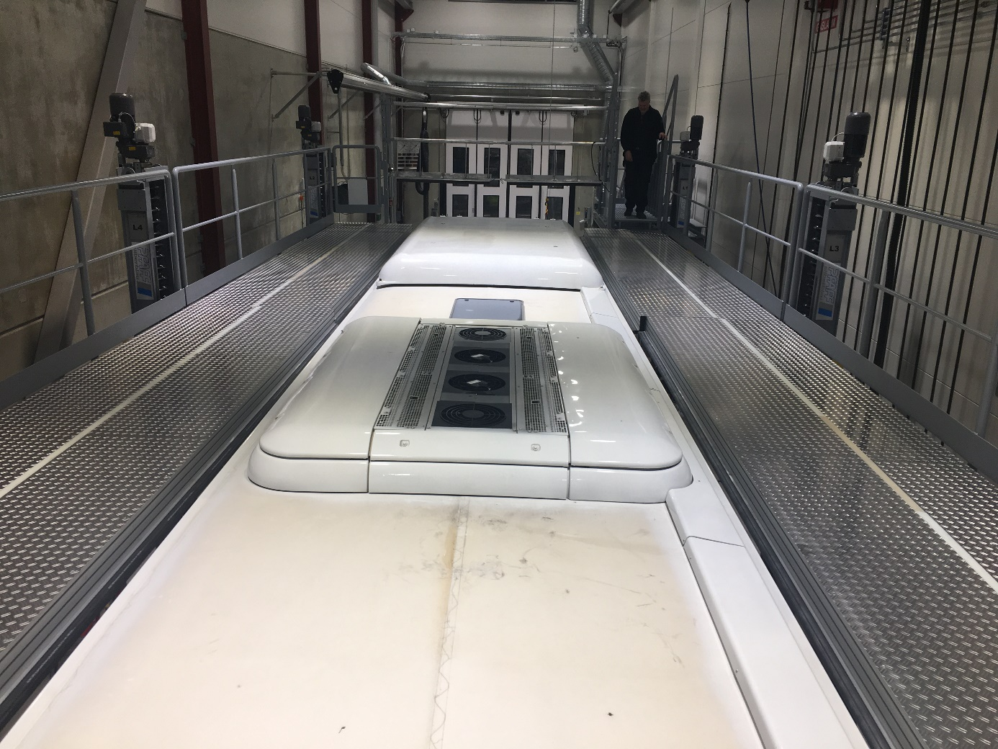
Safe work on the roof of the vehicle
Extendible roof platforms are common within the railway industry where the trains have had lots of components on the roof for a long time.
The same technology works for busses
Pfaff and Dendro Lift has a lot of experience from large installations around the world

Slide 7
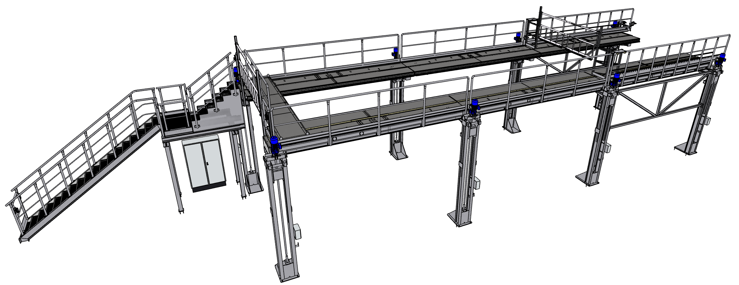
Roof platform for busses
Available with both fixed and flexible height
  Can be combined with a sub-floor or wheel lift
The fixed height can be customized according to needs
Flexible height 1,0 - 4,4 m
The lenght ca be customized according to needs: 12, 15, 18, 21 or 24 m
Can be placed in a row
Can be customized to existing buildings
The staircase is automatically adjusted to the height

Slide 8
Roof platforms for busses
Example

Slide 9
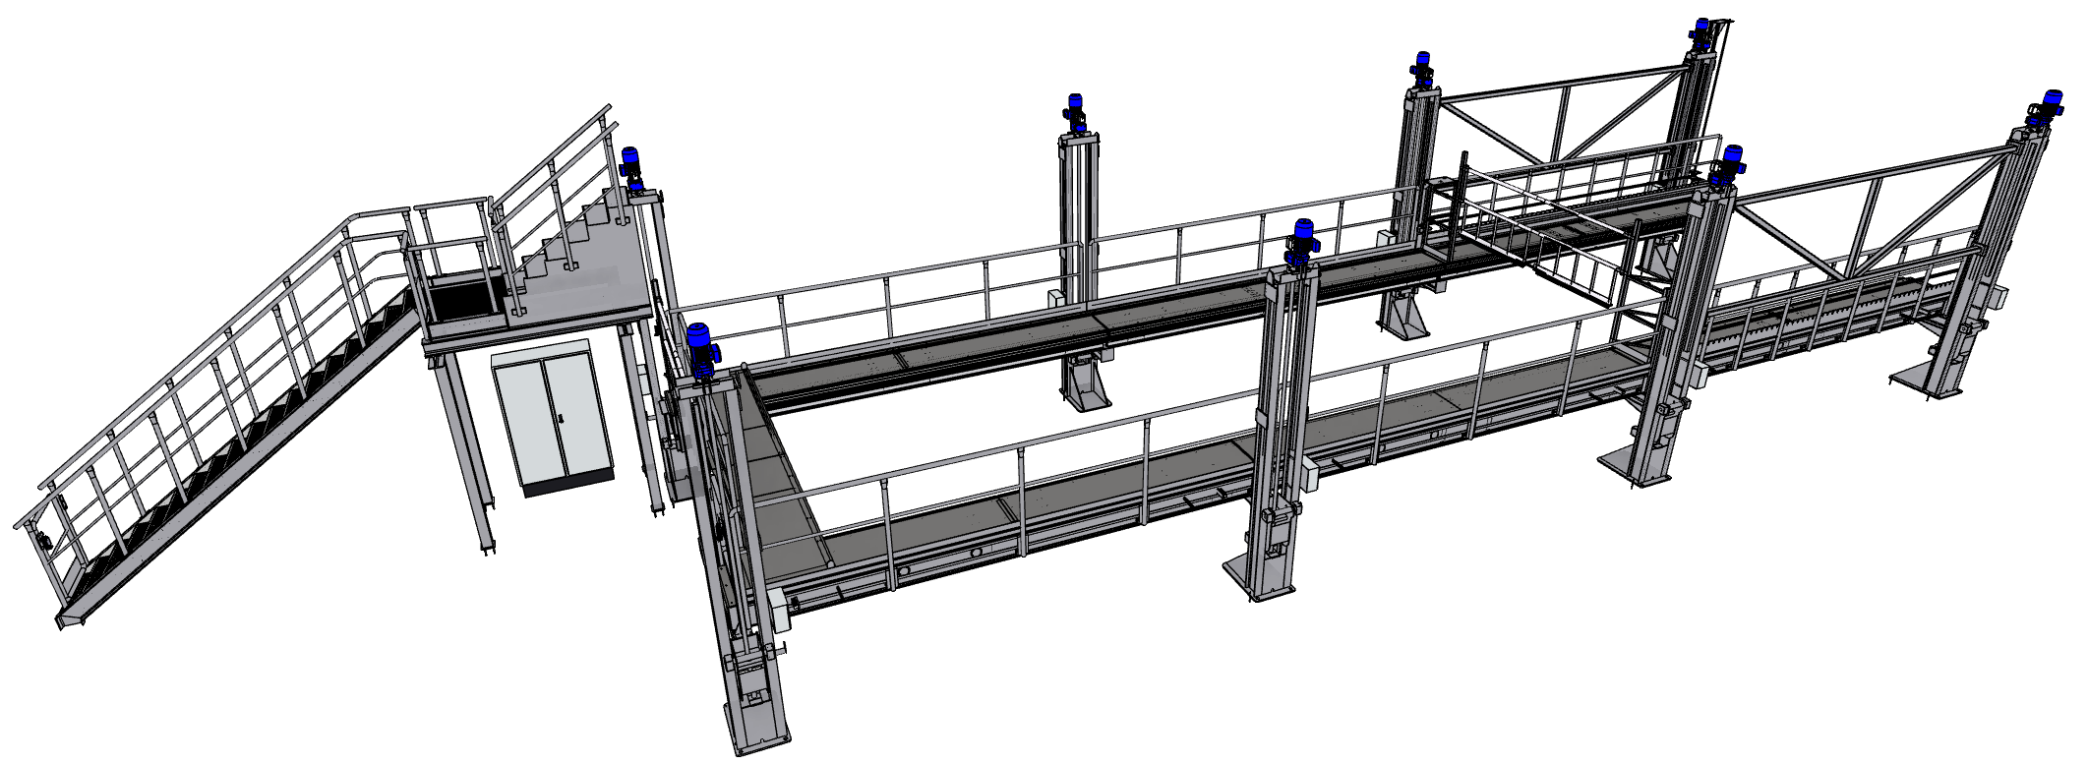
Roof platform with adjustable height
If flexible height is chosen, the platforms can be adjusted to the vehicle's roof height as well as being lowered, which is useful for example when changing windows.

Slide 10
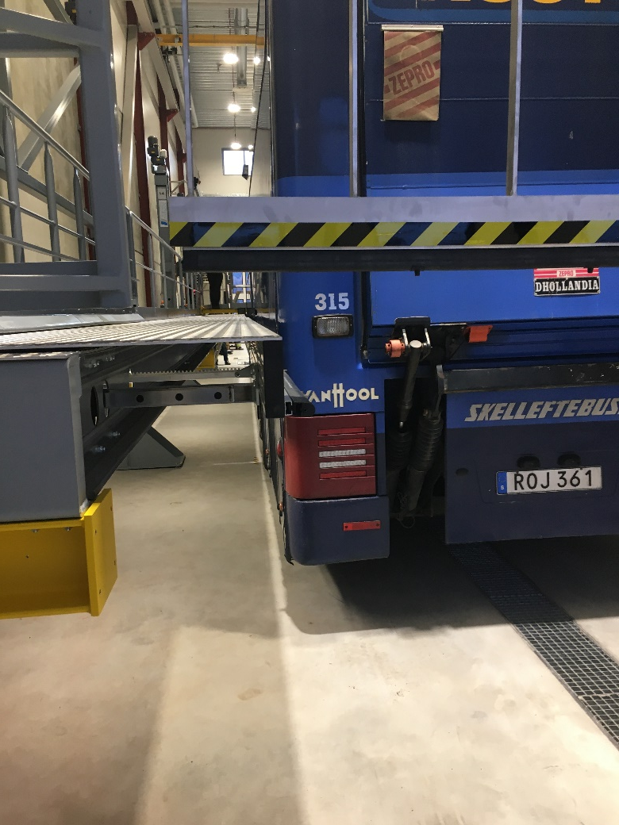
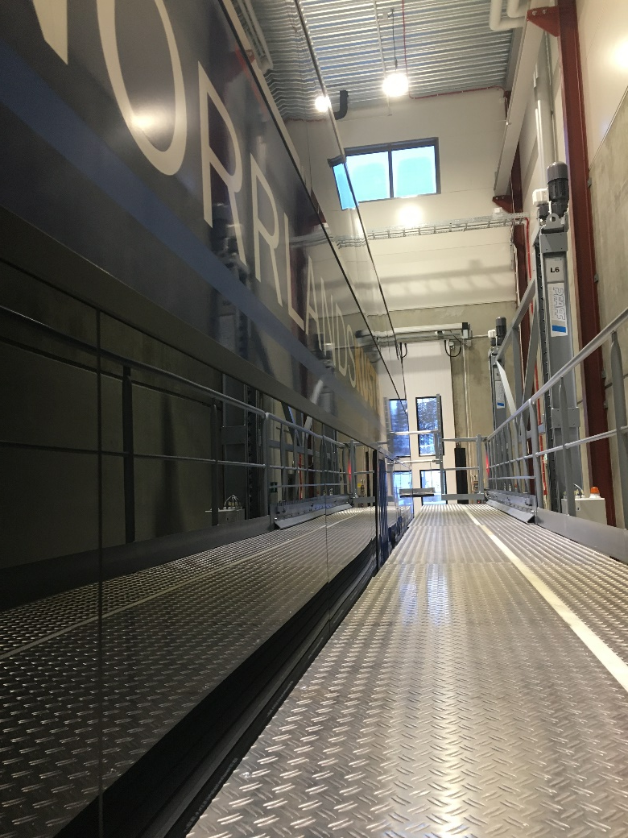
The possibility to change side windows
By lowering the platform, it can be used to, as an example, change windows or other work on the side of the bus.

Slide 11
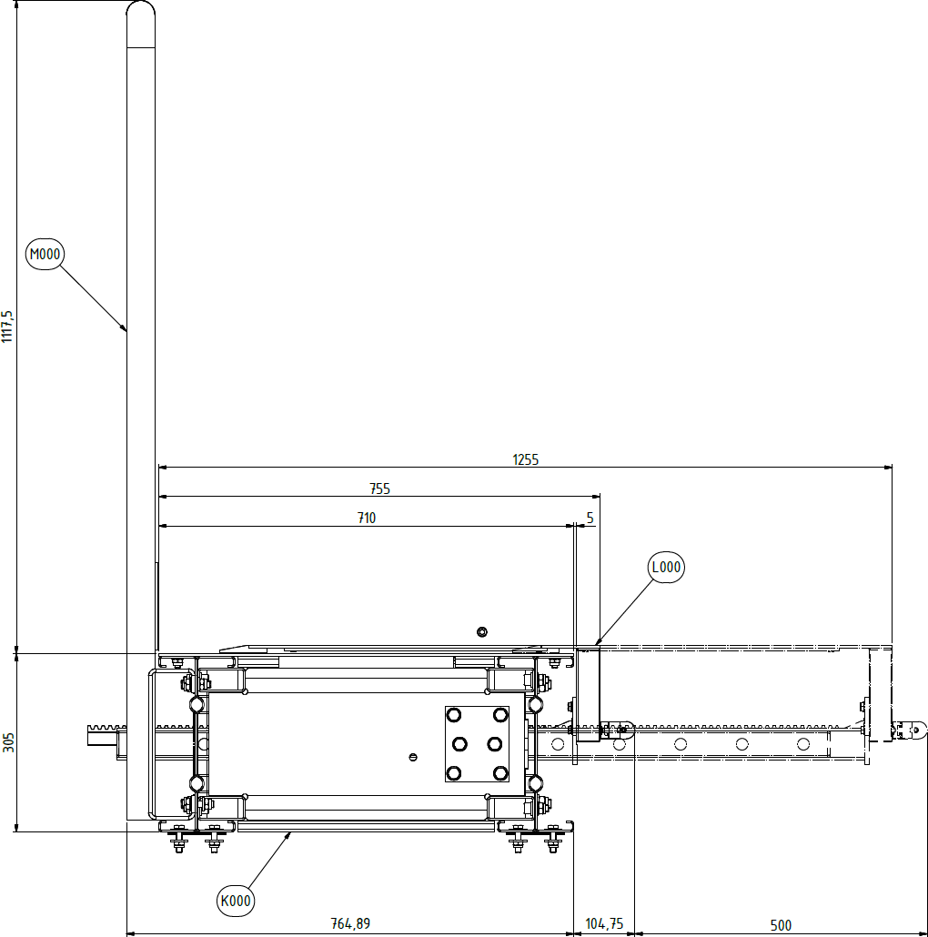
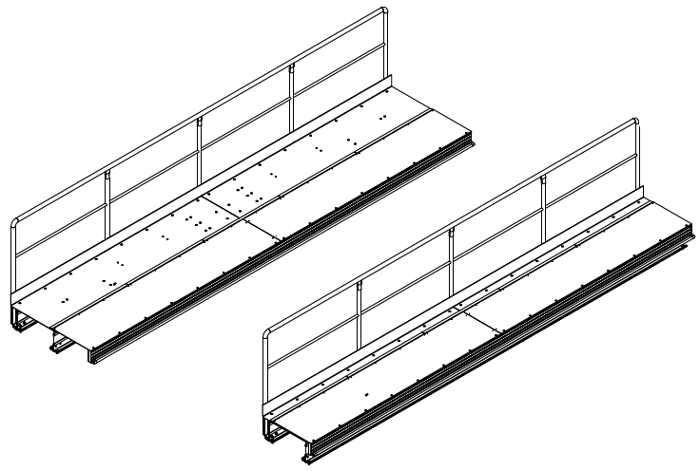
Working platform
Length of segment = 6 - 10 m
Other measurements are available
Length when extended = 500 mm 200-800 mm possible
Width of fixed platform = 755 mm

Slide 12
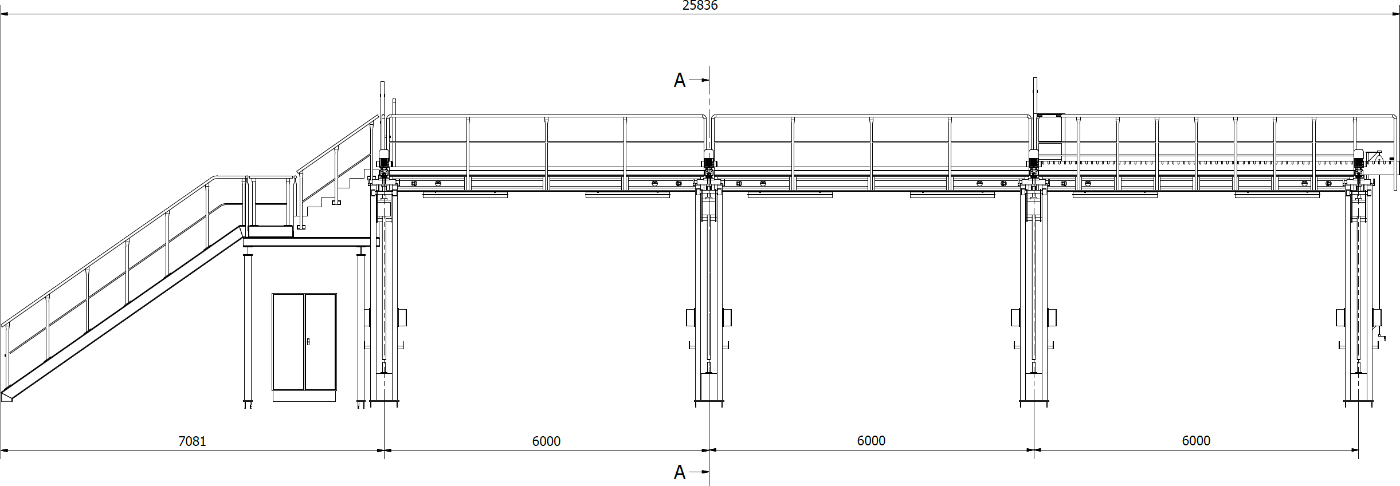
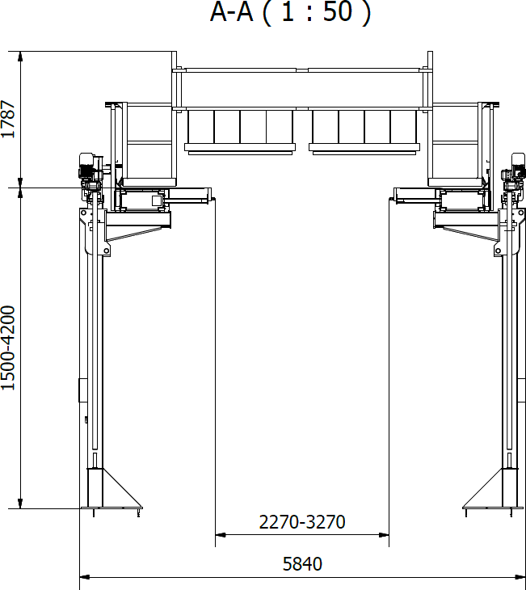
Example drawing

Slide 13
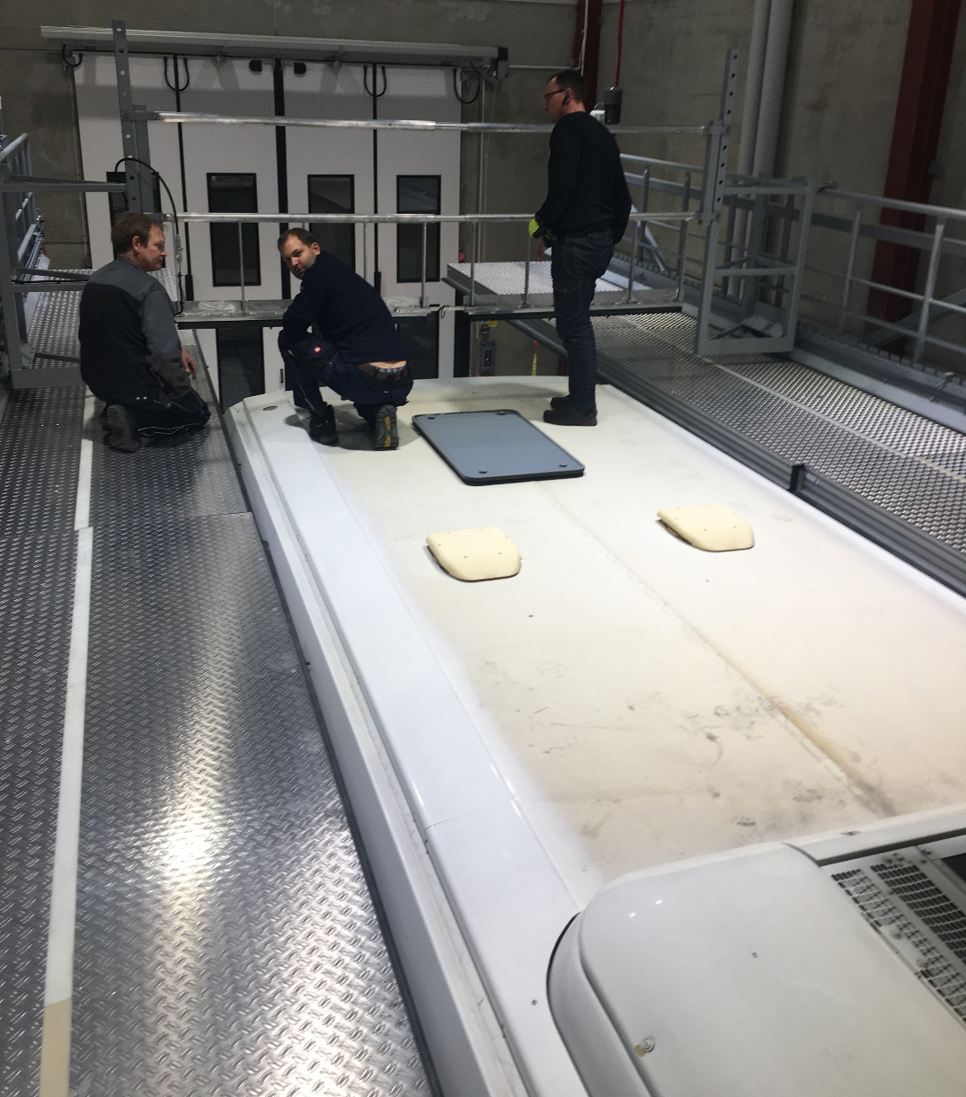
Working platform
Creates a smooth floor against the vehicle
Non-slip protection according to class R11/R12
Risk of falling is eliminated

Slide 14
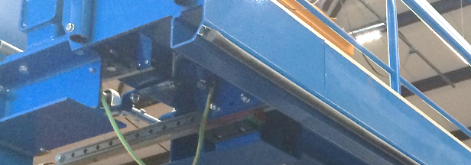
Automatic stop
On all segments there is a soft safety edge protection that automatically stops the platform when it meets the vehicle, then reverse it back about 5 mm.
As an option, the solution can be supplemented with ultrasonic transducers that stop the platforms just before contact with the vehicle. These work regardless of the material (metal, plastic, glass, etc.) that it goes against.

Slide 15
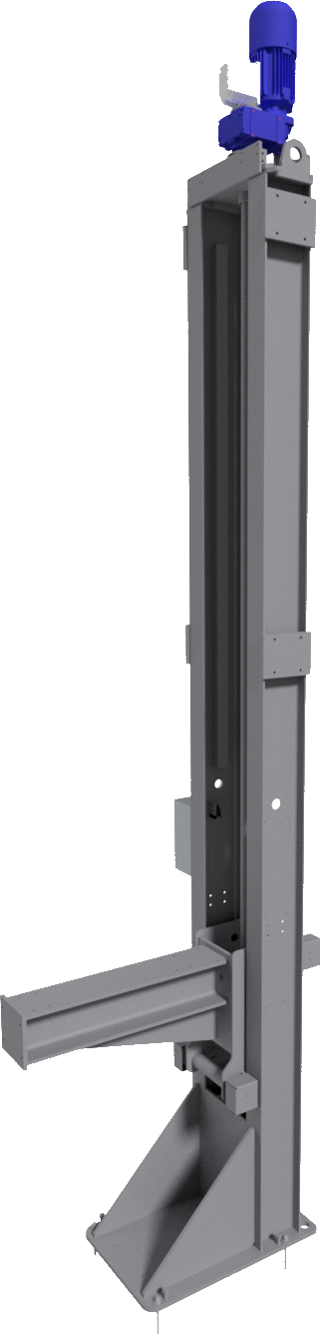
Height-Adjustable Platforms
Ability to automatically raise both platforms in order to fit buses with different ceiling heights
Lifting speed approx. 500mm/min
Lifting mechanism on the pillars, based on self-locking trapezoid threaded screw jacks
Powered by synchronized 3-Phase brake motors
Staircase that automatically adapts to the new height

Slide 16
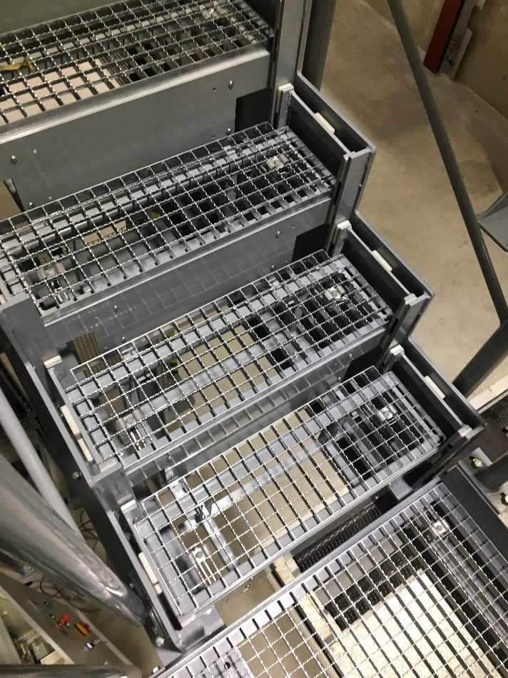
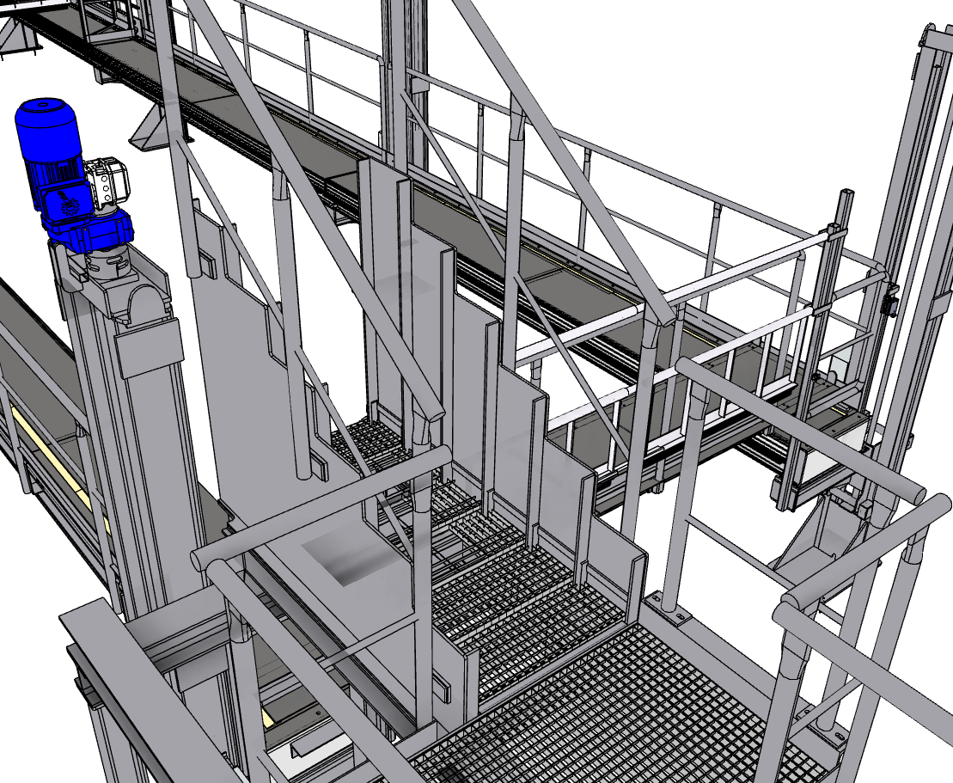
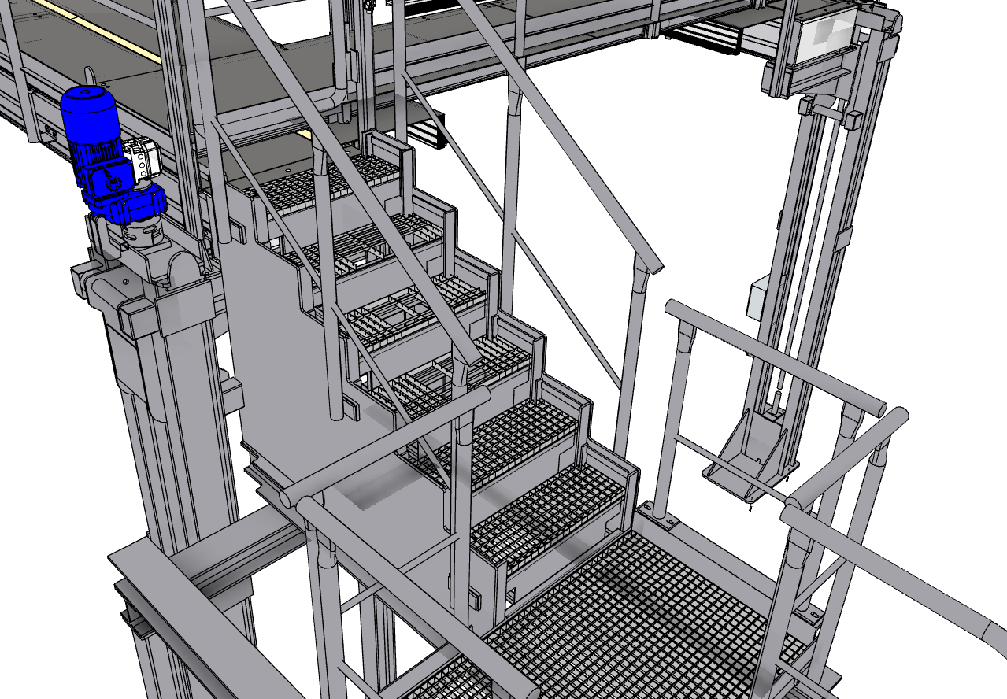
Adjustable staircase with correct step height

Slide 17
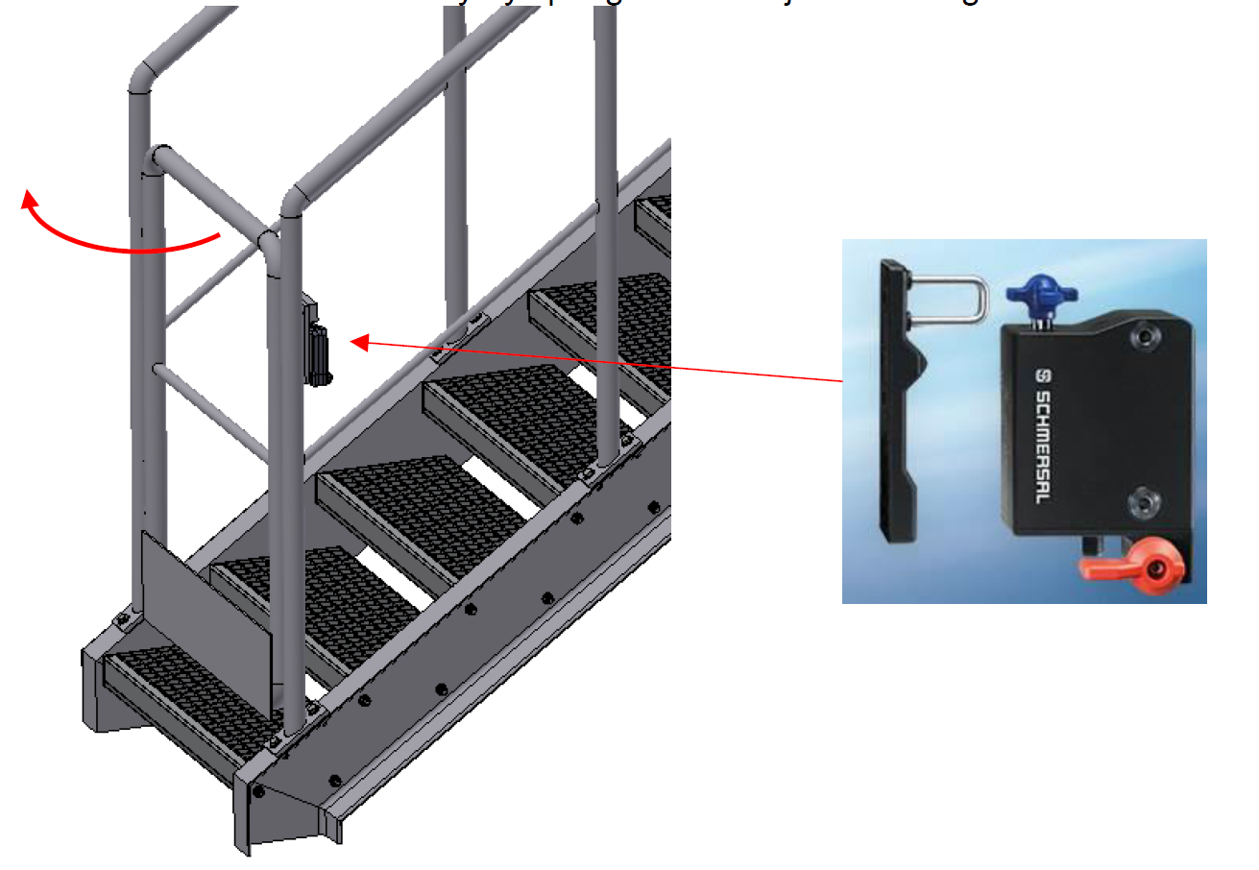
Door to stair case
The door is monitored and locked if the platforms are not extended to the bus.
The door closes automatically by spring loaded adjustable hinges.

Slide 18
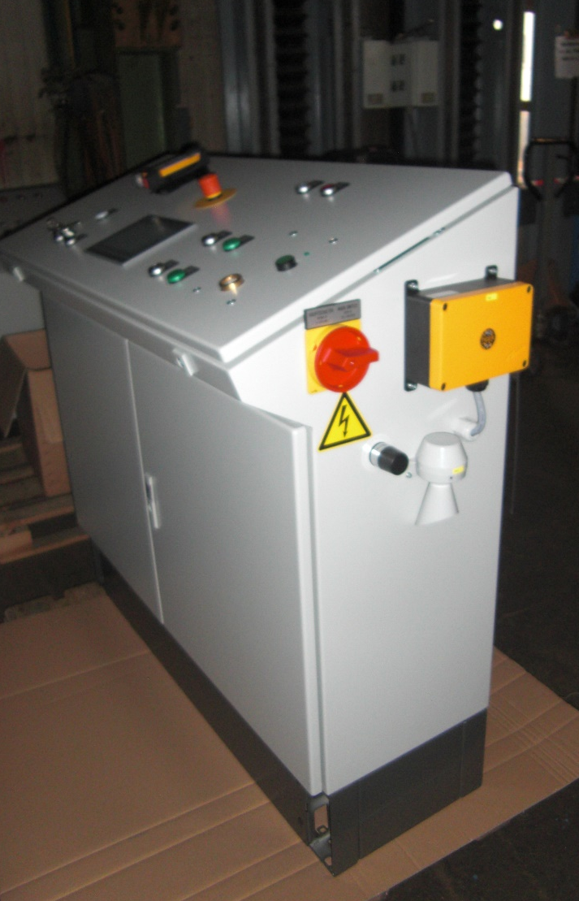
Control cabinet
Desing can be customized accoring to needs.
Is mounted under the fixed platform, under the staircase or on a placement of your choosing in connection to the roof platform.

Slide 19
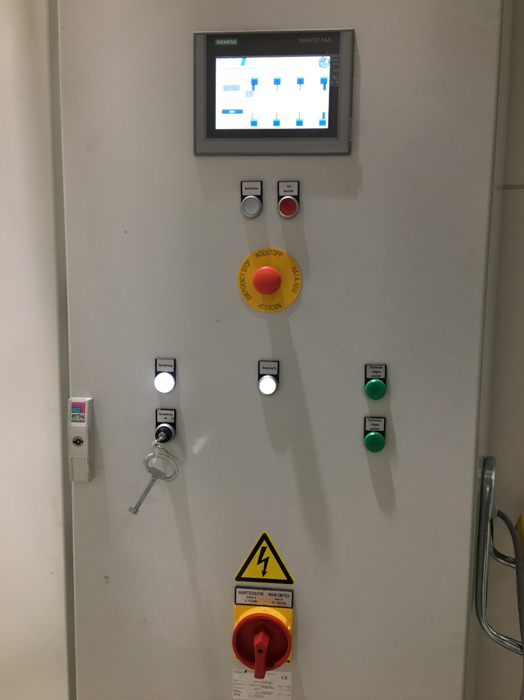
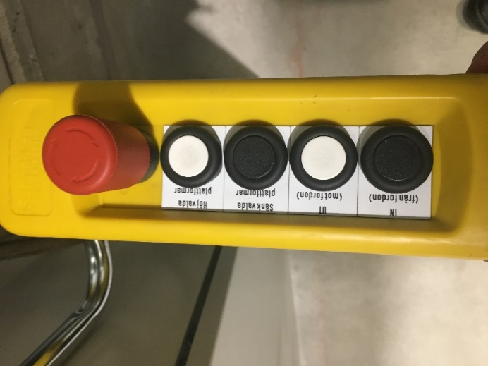
Operator panel
  The operator panel i placed on the central control cabinet. Here you choose how the platforms are used via a touch display.
  If the platforms are height adjustable, it is done here.
  Remote control with a long cord gives an overbiew when adjusting height and width

Slide 20
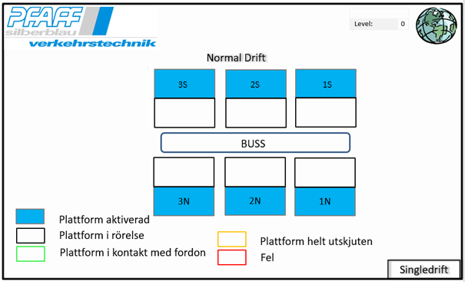
Control panel
Touch display in English or local language to control all or individual platform segments.
Individual segments can be retracted separately.

Slide 21
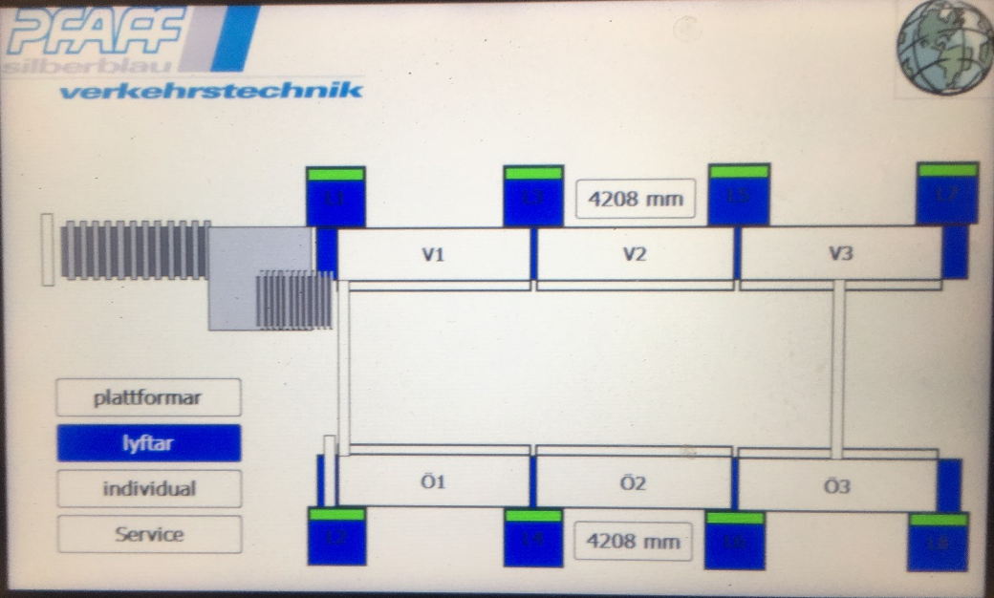
Kontrollpanel
Touch display in English or local language to control all or individual platform segments.
All lifts are driven synchronized.
  Possible to have a slight height difference between right and left side in order to handle different bus models.
All platforms can be extended synchronized and individual segments can be withdrawn separately

Slide 22
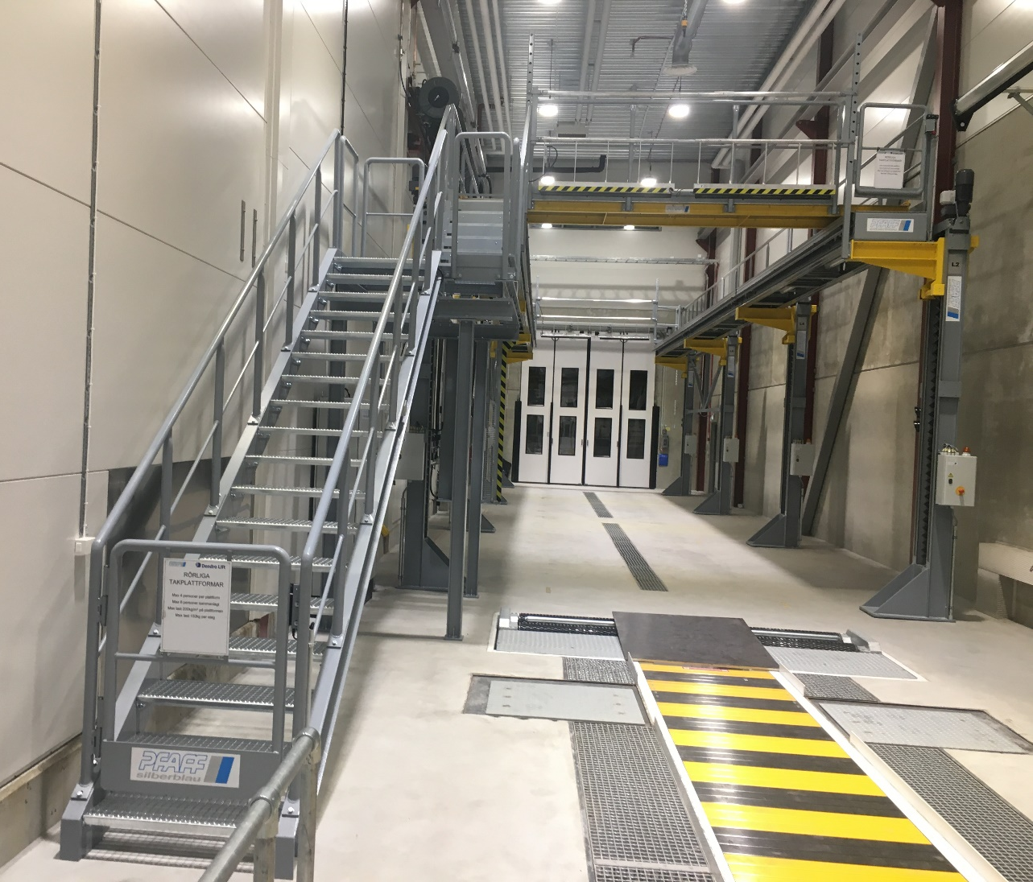
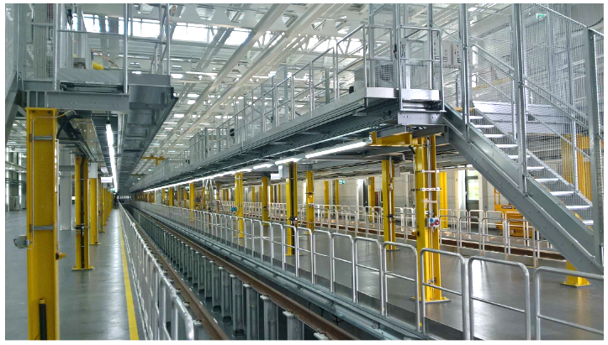
Platform installation
Comes complete, including stairs, guardrails, pillars to the floor
4 pillars per side, in the center under each platform
Affixed with Chemical anchor bolts
Installation time approx. 1 week

Slide 23
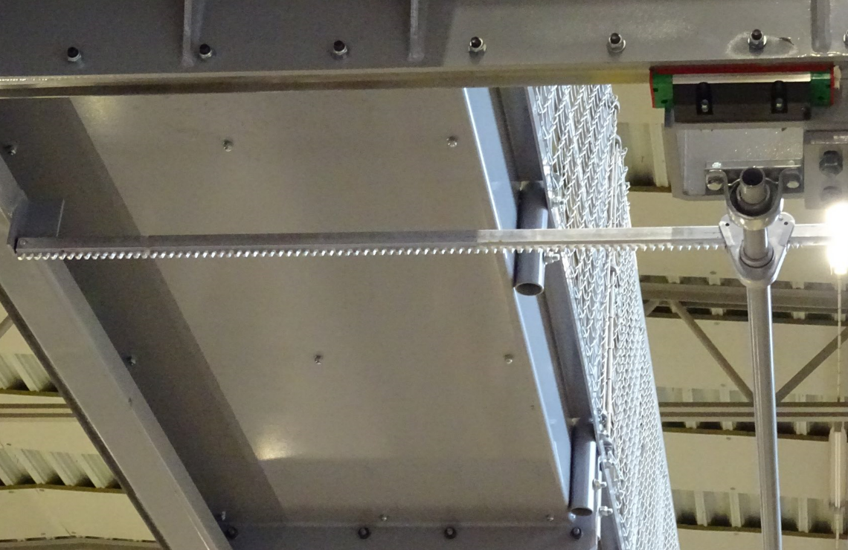
Platform control
One 0.11 kW AC motor of per segment.
Rack and pinion operation.
Sliding platform extension 200-600 mm (can be up to 800 mm).
  200-400 mm recommended

Slide 24
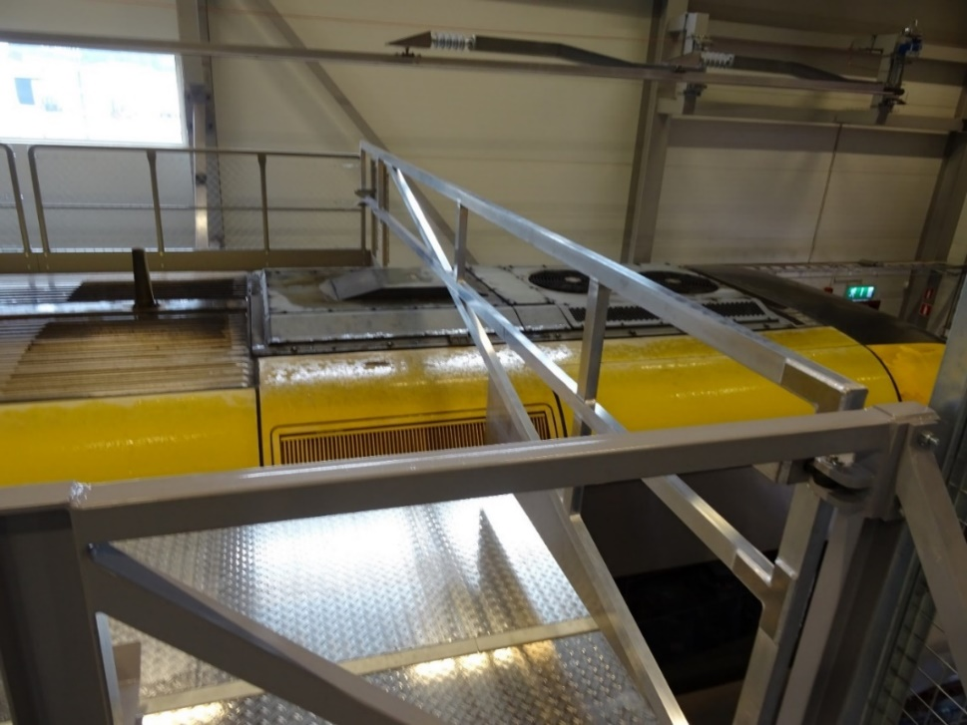
Safety gates at the end
Aluminum swivel gate.
Electronically supervised.
Adjustable longitudinal, with crank or electrically

Slide 25
Removable front bridge
For maintenance at the front of the vehicle (front window etc.) there is a removable front bridge, that can be laid on the front-end sides of the platforms by an over head crane

Slide 26
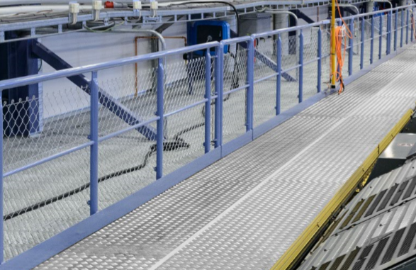
Guardrails
110 cm high guard rails with kick plate and safety net.

Slide 27
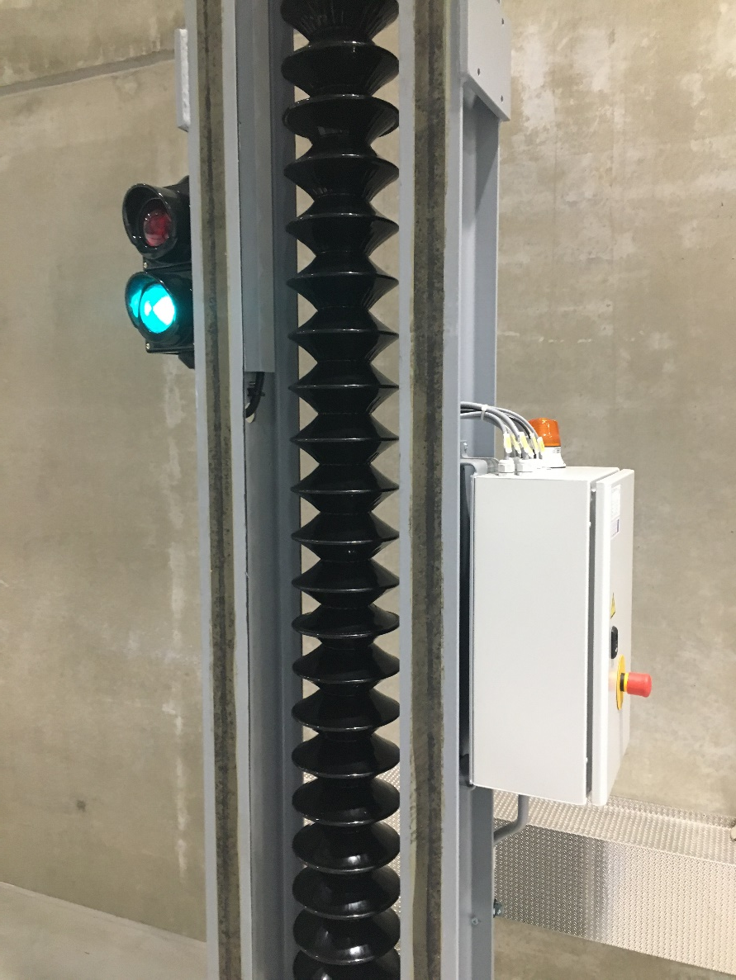
Traffic lights at the end
Green light shows that the platforms are contracted and that it’s free to drive bus in or out.
If the platforms have adjustable height, each pillar is equipped with at blinking light to indicate movement

Slide 28
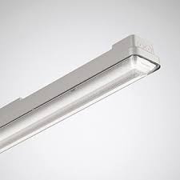
Lamps under the platforms
Built in LED lamps under the platforms provides good working light underneath

Slide 29
Other
Max 5 people on the platform at the same time
Can be delivered in any RAL color.
CE marked according to ISO 14122 (requirements for safe access to machinery) and Machinery Directive 2006/42 EC.
Requires 40A fuse for adjustable height, 10A for fixed
Shipping, installation, training and documentation is included.
Installation time is about 1-2 weeks.
Delivery time about 4-6 months
Swedish references:
  Brixly Jönköping
  Skellefteå Bus
  Jernhusen, Sävenäs, Gothenburg
  Mälab, Eskilstuna
  BS Verkstäder, Falköping

